Slide 1



Conditional Statements
A guide in Python
Notes:
Welcome back! In this video, we will be discussing conditional statements, but what are conditional statements?
Well, conditional statements allow us to make decisions based on the values of variables or the result of comparisons, and in Python, they are used to execute a specific block of code based on the truth value of a condition.

Slide 2


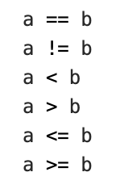
Conditions
Notes:
Python supports the usual logical mathematical conditions such as a is equal to b, a is not equal to b, a is less than b, a is greater than b, a is less than or equal to b, and a is greater than or equal to b.

Slide 3
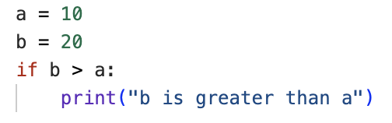
If Statements
Notes:
The most common way these conditions can be used is in if statements.
An if statement is written by using the keyword if, followed by a condition, followed by a colon, followed by an indented block of code (in this example, the print statement) to execute if the condition is true. Python relies on indentation (denoted by the vertical grey line under the word if), and without this, the if statement will raise an error.
Here, as a = 10 and b = 20, this if statement will return b is greater than a based on the given condition. But what would happen if b was not greater than a?

Slide 4
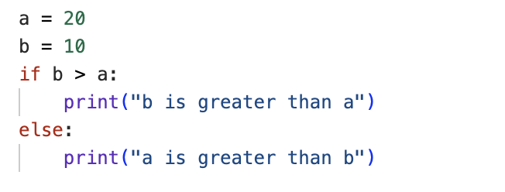
If Statements
Notes:
In this example, we have added an extra aspect to the if statement in the form of the keyword else to catch anything which isn’t caught by the preceding if condition. Here, you can see that the if statement returns a is greater than b as the values of a and b have been reversed.
But what happens if a is equal to b?

Slide 5
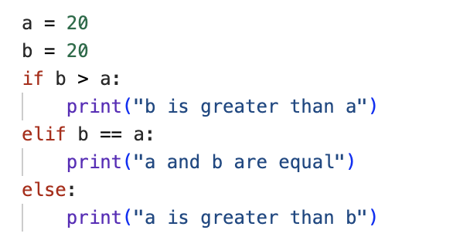

If Statements
Notes:
In this, our final example, we introduce the keyword elif, which introduces another condition for if the preceding if condition is not true. In this case, the keyword else is now catching anything not caught by either of the conditions introduced by if or elif. Here, the statement returns a and b are equal, as a and b are both equal to 20, fulfilling the elif condition.

Slide 6
Write an if statement that outputs the following values based on the comparison between and b:
Print ‘apple’ if a is greater than b
Print ‘banana’ if a is equal to b
Print ‘cherry’ if b is greater than a
Print the output of this statement if a = 5 and b = 2.
Challenge Yourself
Notes:
And that’s this lesson on conditional statements complete. Now we would like to give you the opportunity to challenge yourself by trying the assignment set on this slide.
Answers will be discussed in the following slide, so make sure to pause this video now while you work through the task.

Slide 7
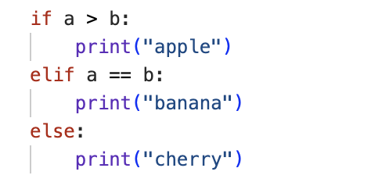


Notes:
We asked you to try writing an if statement that outputs ‘apple’ if a is greater than b, ‘banana’ if a is equal to b, and ‘cherry' for anything else, so our code uses the keywords if, elif, and else. This means that when a = 5 and b = 2, the output of the statement is apple.
How did you find this? If you got it right, congratulations! If not, that’s okay. We don’t always get things right on the first try. There’s still plenty of time to learn, and the teaching staff will be happy to work through any problems with you. Just give us a shout!
Otherwise, see you in the next video.

